Slide 1

Day 2 Hands on:
DFT Bread and Butter
Tutors: Chiara Cignarella / Alberto Carta / Nelson Dzade / George Manyali / James Sifuna / Fatema Mohamed / Omamuyovwi Rita Jolayemi / Maram Ali Ahmed Musa
Brief description of the tutorials:
1) Single DFT calculations: benzene and graphene
2) Silicon: convergence test and lattice optimization
3) Optional: carbyne chain, convergence test for vacuum

Slide 2
Topics of the session
1. The basics: benzene and graphene
Single molecule calculations: benzene
Basics of post-processing: plotting wavefunctions
Periodic systems: graphene
2. DFT bread and butter: convergence tests and lattice optimization
Basic convergence tests on fcc Si: energy cutoff and k-grid
Optimizing the lattice constant: Extracting physical information: bulk modulus
3. Optional: the carbyne chain
Converge test and structure optimization
To get the latest version of the exercises, in the ASESMA 2025 folder execute: `git pull`

Slide 3
About Quantum ESPRESSO
More info about Quantum ESPRESSO can be found in:
Quantum ESPRESSO (QE) documentation:
Useful resources:
https://www.quantum-espresso.org/
on-line (pw.x code) and (pp.x code) manuals and
for input file description
Input generator from materials cloud
Pseudopotentials SSSP library and GBRV library

Slide 4

Exercise 1.1 : Benzene
How to calculate and plot molecular orbitals of benzene ($(sign ψ\left(r\right))∙{\left|ψ\left(r\right)\right|}^{2}$)

Slide 5
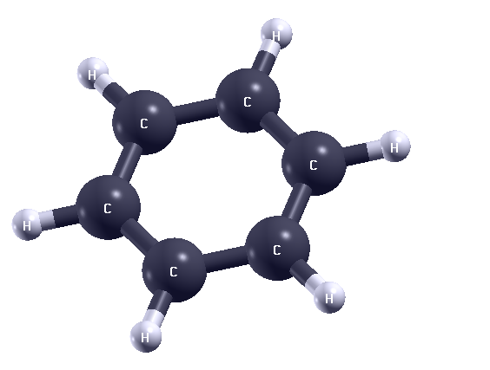
1. Exercise 1: Benzene
Step 0: View the Benzene Molecule
Move the mouse around to take a look at the molecule.
The ".pwi" format stands for quantum espresso pw.x input file.
For a pw.x output file, that would be ".pwo”
xcrysden --pwi pw.benzene.scf.in

Slide 6
1. Exercise 1: Benzene
Step 0: View the Benzene Molecule
Move the mouse around to take a look at the molecule.
The ".pwi" format stands for quantum espresso pw.x input file.
For a pw.x output file, that would be ".pwo”
Step 1: Perform the SCF Calculation
The pw.x code will now perform a DFT self - consistent field (SCF) calculation.
xcrysden --pwi pw.benzene.scf.in
pw.x –in pw.benzene.scf.in > pw.benzene.scf.out

Slide 7

1. Exercise 1: Benzene
Step 2: Postprocess the wavefunction data
The resulting wavefunction amplitudes are written to files psi2.benzene_K001_B0*.xsf
pp.x –in pp.benzene.psi2.in > pp.benzene.psi2.out
$$sign ψ\left(r\right))∙{\left|ψ\left(r\right)\right|}^{2}$$

Slide 8
1. Exercise 1: Benzene
Step 2: Postprocess the wavefunction data
The resulting wavefunction amplitudes are written to files psi2.benzene_K001_B0*.xsf
Step 3: Plot a single molecular orbital
Make a fancy display of the molecular orbital (follow the instructions of the tutor). The README.md contains the info necessary to save the current state view. You can try and save that as MO-state.xcrysden and then use the same view with another orbital:
pp.x –in pp.benzene.psi2.in > pp.benzene.psi2.out
$$sign ψ\left(r\right))∙{\left|ψ\left(r\right)\right|}^{2}$$
xcrysden --xsf psi2.benzene_K001_B006.xsf
xcrysden --xsf psi2.benzene_K001_B006.xsf –script MO-state.xcrysden

Slide 9
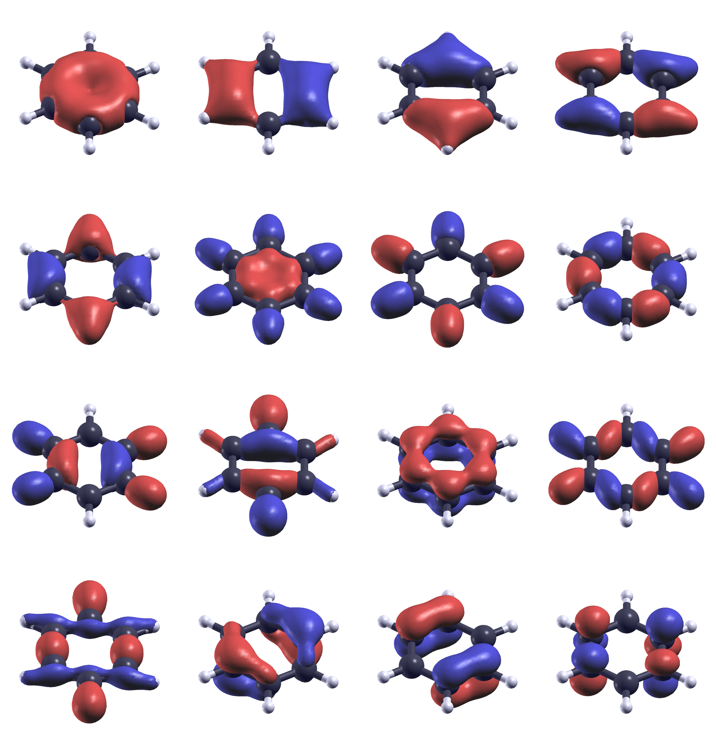
1. Exercise 1: Benzene
Step 4: Plot All Molecular Orbitals
Run in the terminal:
The shell script is trying to plot all wavefunctions
you computed, be patient (this will take a while).
bash plot-psi2.sh

Slide 10
Exercise 1.2: Graphene
Introduction to periodic system

Slide 11
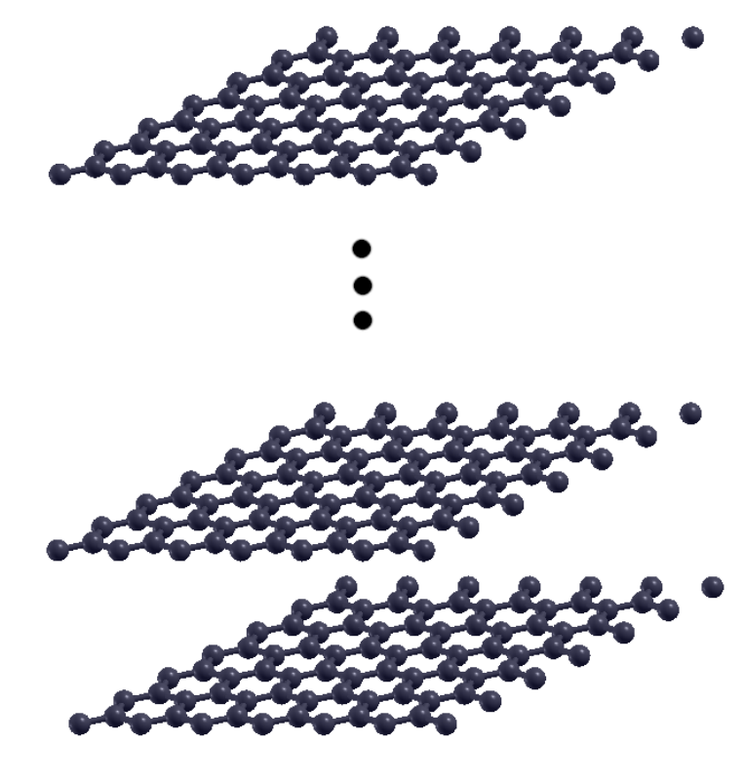
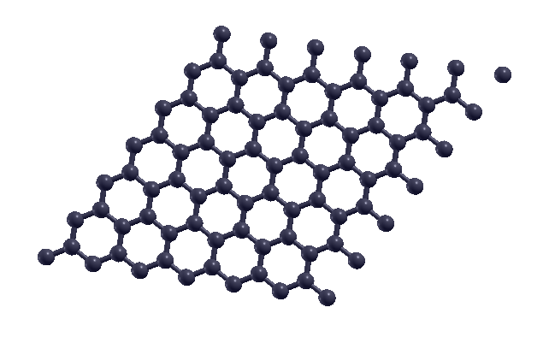
1. Exercise 2: Graphene
Graphene is a single sheet of carbon atoms
Periodic boundary conditions are applied in the plane
But in quantum espresso every direction is periodic

Slide 12
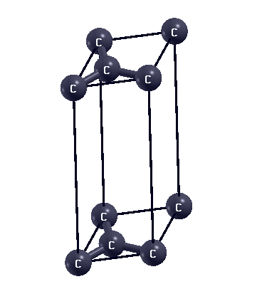
1. Exercise 2: Graphene
Graphene is a single sheet of carbon atoms
We can describe the graphene sheet with just 2 atoms in the unit cell

Slide 13
1. Exercise 2: DOS of Graphene
The scheme to compute the DOS is the following:
Perform the SCF Calculation: Use pw.x to calculate the density (calculation = ’scf’)
pw.x –in pw.graphene.scf.in > pw.graphene.scf.out
Perform the NSCF Calculation: Use pw.x to calculate the electronic eigenvalues on more k-point grids (calculation = ’nscf’)
pw.x –in pw.graphene.nscf.in> pw.graphene.nscf.out
Calculate DOS datafile: Use dos.x to compute the total DOS and save it to graphene.dos.
dos.x –in dos.graphene.in > dos.graphene.out
Plot DOS with gnuplot: Use gnuplot to plot the DOS saved in graphene.dos.
gnuplot dos.gp

Slide 14
1. Exercise 2: DOS of Graphene
Replot DOS shifted to the Fermi energy
Find the Fermi energy:
grep “Fermi” pw.graphene.nscf.out
Use the Fermi energy value from the output and edit dos.gp files accordingly.
gnuplot dos.gp

Slide 15
Exercise 2 : Silicon
Bread and butter of real DFT calculations

Slide 16
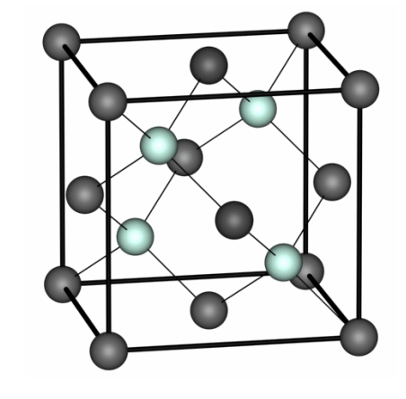
2. Exercise 1: Silicon
bulk silicon is a face-centered cubic (FCC) lattice with 2 atoms in the unit cell at positions [0 0 0] and [1/4 1/4 1/4] (this is also called diamond or zinc-blend structure)
&CONTROL
calculation = 'scf’,
prefix = 'silicon’,
pseudo_dir = '../../pseudo/’,
outdir = './tmp’
/
&SYSTEM
ibrav = 2,
celldm(1) = 10.2,
nat = 2,
ntyp = 1,
ecutwfc = 28,
/
&ELECTRONS
/
ATOMIC_SPECIES
Si 28.086 Si.pbe-rrkj.UPF
ATOMIC_POSITIONS
Si 0.00. 0.00. 0.00
Si 0.25. 0.25 0.25
K_POINTS automatic
4 4 4 1 1 1

Slide 17
2. Exercise 1: Silicon
ibrav=2: meaning FCC lattice
Just one: celldm(1)=10.2, lattice parameter a in Bohr
nat=2: two atoms
ntyp=1: one distinct atomic specie
Where are the atoms located in the unit cell? See card ATOMIC POSITIONS: here, in Cartesian axes, in units of a
&CONTROL
calculation = 'scf’,
prefix = 'silicon’,
pseudo_dir = '../../pseudo/’,
outdir = './tmp’
/
&SYSTEM
ibrav = 2,
celldm(1) = 10.2,
nat = 2,
ntyp = 1,
ecutwfc = 28,
/
&ELECTRONS
/
ATOMIC_SPECIES
Si 28.086 Si.pz-vbc.UPF
ATOMIC_POSITIONS
Si 0.00. 0.00. 0.00
Si 0.25. 0.25 0.25
K_POINTS automatic
4 4 4 1 1 1

Slide 18
2. Logic of the examples:
Convergence tests for Si bulk consist of the following steps:
Converge the basis-set
Converge the k-points
With converged basis-set and k-points, calculate the lattice parameter of FCC bulk Si
With converged basis-set, k-points, and lattice parameter, fit the bulk modulus of FCC Si
Description of folder structure:
ex1.ecutwfc/ Convergence tests for cutoff energy
ex2.kpoints/ Convergence tests for k-points
ex3.alat/ Search of lattice parameter of Si bulk (alat = a lattice parameter)

Slide 19
Kinetic Energy Cutoff (ecutwfc)
The kinetic energy cutoff ecutwfc (in Ry) determines the size of the Plane-Wave (PW) basis set used to expand wavefunctions (i.e. Kohn-Sham orbitals). The default value for the charge density is ecutrho=4*ecutwfc, which is suitable for norm-conserving pseudopotentials.
A manual test of convergence with respect to the kinetic energy cutoff involves the following tasks:
(Note: We will not perform this manually! Follow the instruction on the README.md file):
Change the value of ecutwfc in the pw.si.scf.in input file to different values such as 16, 20, 24, 28, 32 Ry.
For each value of ecutwfc, run pw.x and record the final total energy.
Store the data in a file, let's say si.etot_vs_ecut (each line should contain two values: ecutwfc and total energy).
Plot the energies collected in si.etot vs ecut using your preferred plotting program.
Gnuplot:
Python:
plot "si.etot_vs_ecut" with linespoint
python plot_etot_ecut.py

Slide 20
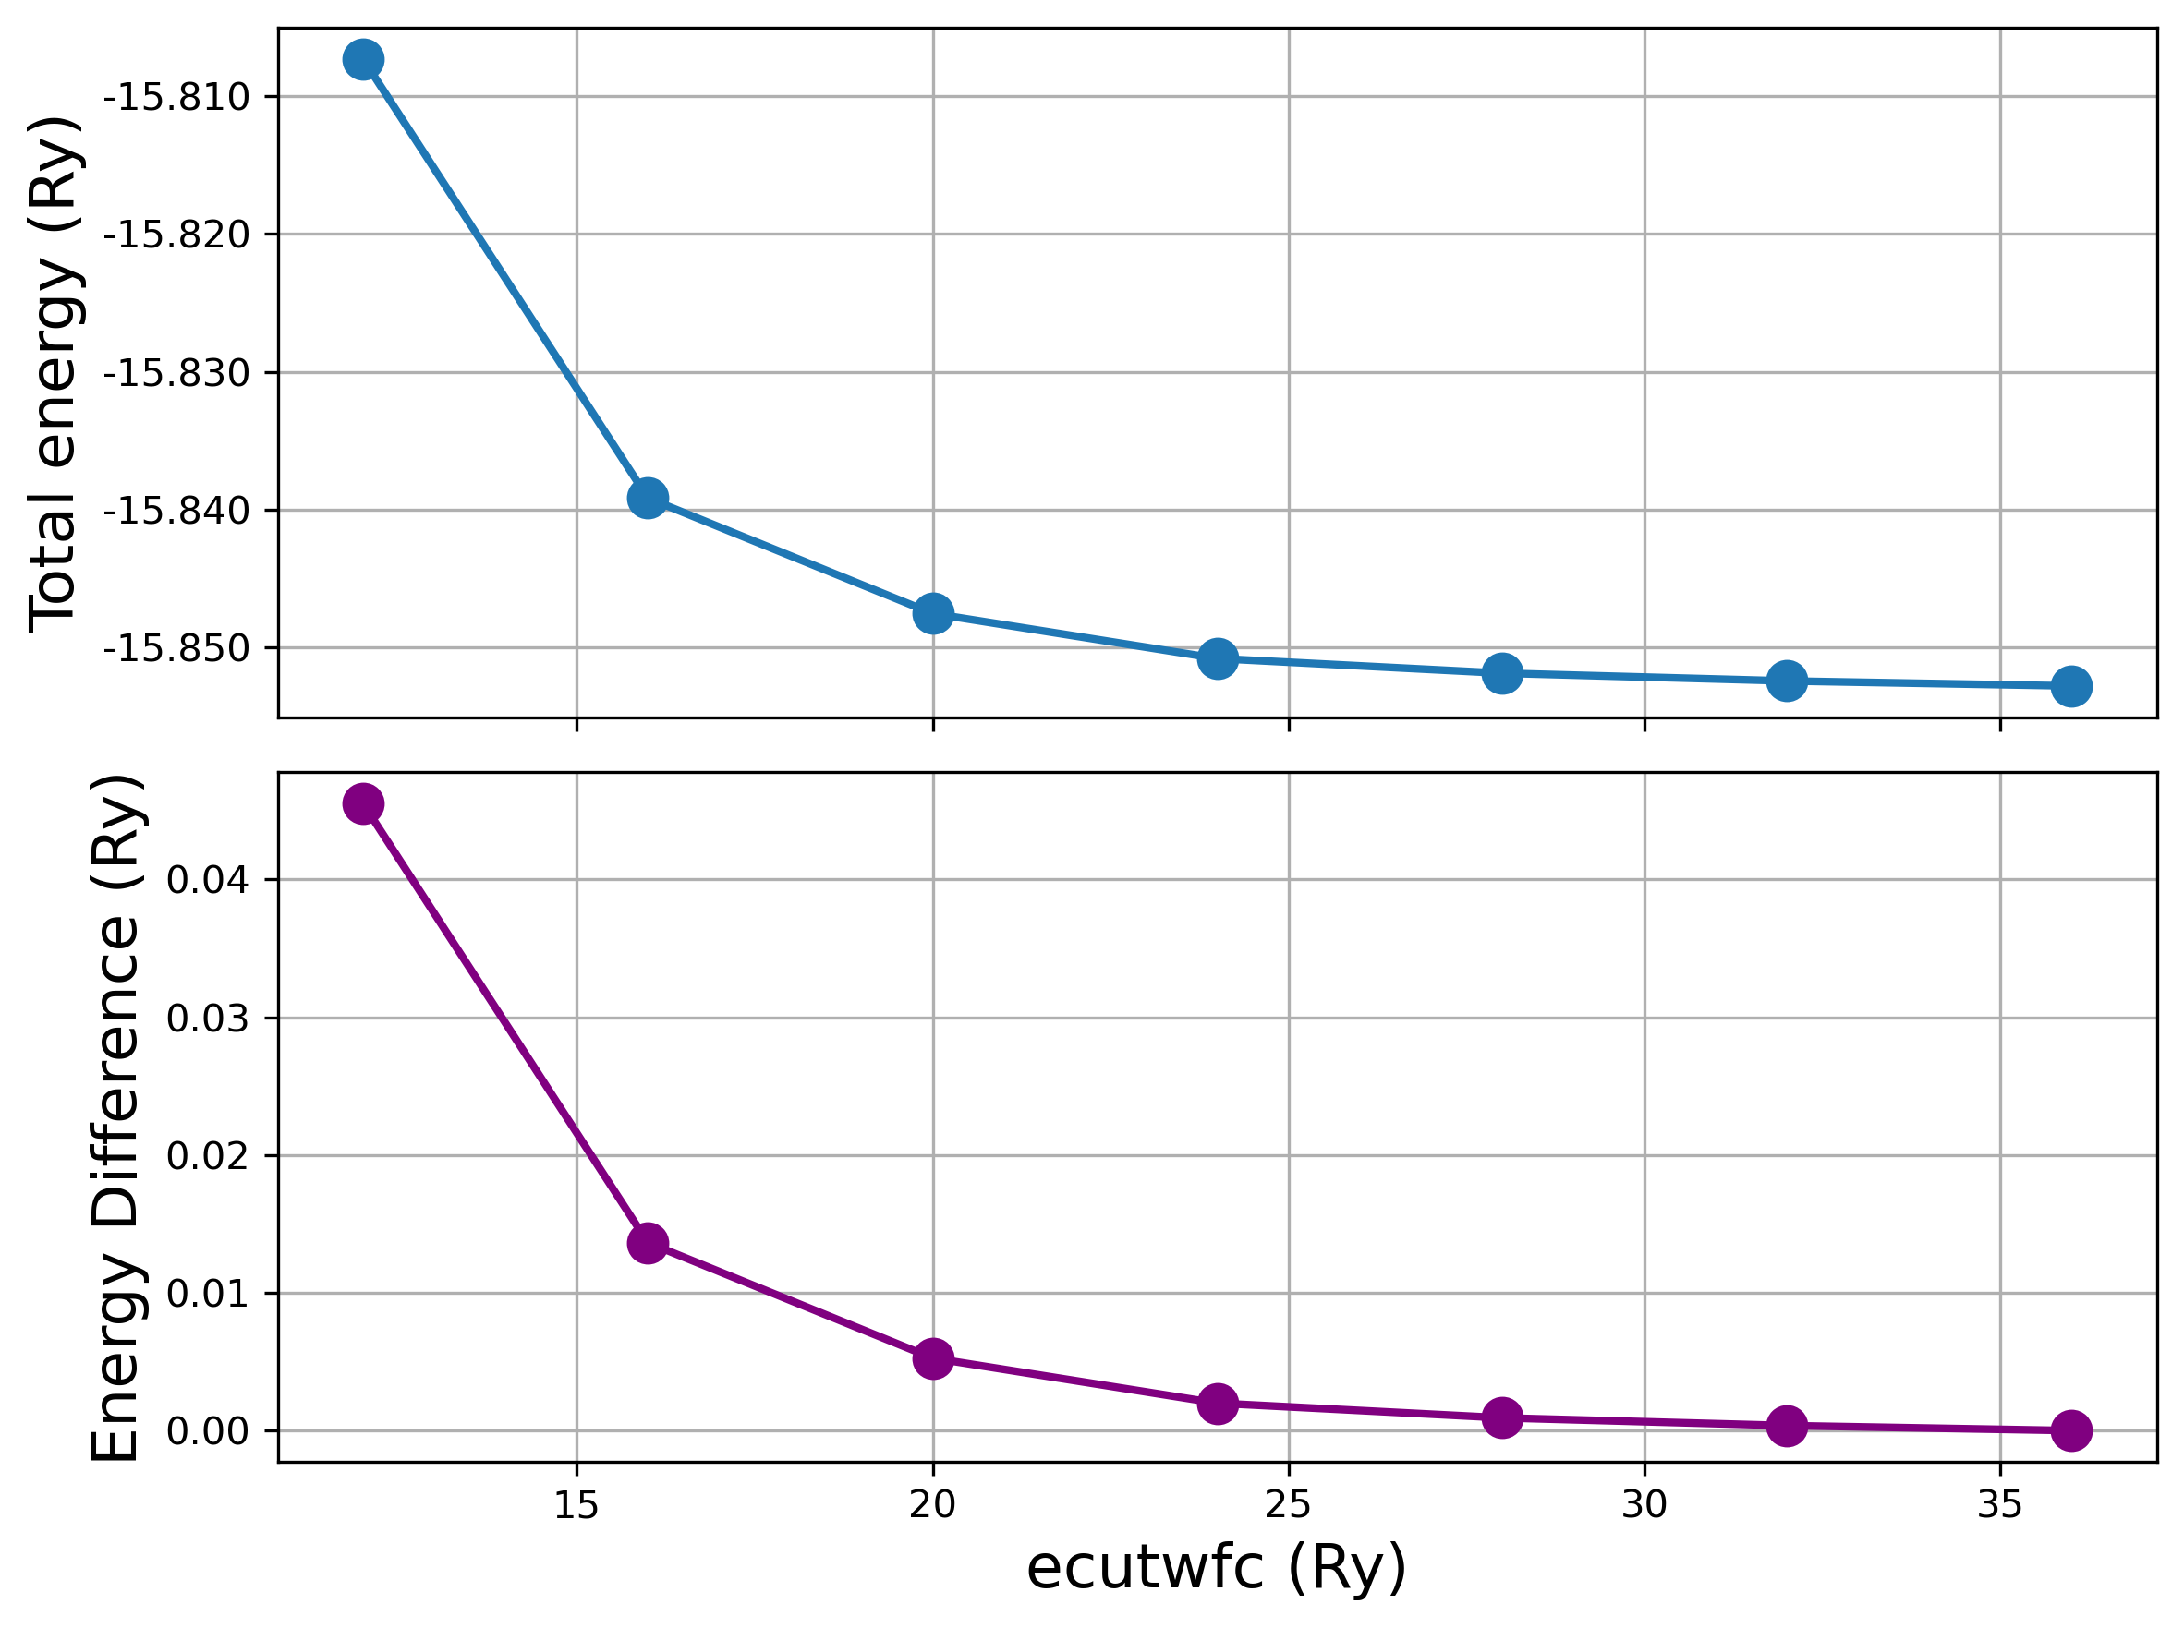
Kinetic Energy Cutoff (ecutwfc)
In the end, we want something like this:
We are looking for differences of < mRy
Note: Absolute values of total energy do not have any physical meaning: only energy differences are meaningful!
12.0000 -15.80731200 16.0000 -15.83916740 20.0000 -15.84754590 24.0000 -15.85081789 28.0000 -15.85188267 32.0000 -15.85244512 36.0000 -15.85280759

Slide 21
Convergence with Respect to K-Points
A sufficiently dense grid of k-points is required to accurately represent the periodicity of the system. To test the convergence with respect to k-points, you can modify the K_POINTS card in your input file. Request automatic Monkhorst-Pack grids using the following format:
Gradually increase the values of nk1, nk2, and nk3 while keeping k1, k2, and k3 equal to 1. For example, you can try increasing nk1 = nk2 = nk3 to 2, 4, 6, 8, and so on. Run the pw.x calculation for each set of k-point values.
The first three nk1 nk2 nk3 numbers indicate the number of grid points along crystal axes 1, 2, 3.
The second three k1 k2 k3 numbers, either 0 or 1, indicate whether the grid starts from 0 or is displaced by half a step along crystal axes 1, 2, 3.
Note:
Convergence is not necessarily monotonic, as there is no variational principle with respect to the number of kpoints. Why do you think this is the case? Try to repeat the example with odd values of nk.
K_POINTS automatic
nk1 nk2 nk3 k1 k2 k3

Slide 22
Lattice parameter determination
In silicon (Si), the equilibrium state is determined solely by the minimum-energy lattice parameter. Due to symmetry, there are no forces on the atoms.
(You can verify this by setting tprnfor=.true. in the namelist &CONTROL and checking for the forces reprinted at the end of the calculation.)

Slide 23
Lattice parameter determination
In silicon (Si), the equilibrium state is determined solely by the minimum-energy lattice parameter. Due to symmetry, there are no forces on the atoms.
(You can verify this by setting tprnfor=.true. in the namelist &CONTROL and checking for the forces reprinted at the end of the calculation.)
To determine the lattice parameter of bulk Si, you can follow these steps:
(as before, you can follow the instruction on the README.md file)
Choose suitable values for ecutwfc (e.g., 36 Ry) and the k-point grid (e.g., 6 6 6 1 1 1);
Run pw.x for values of celldm(1) ranging from 9.7 to 10.8 Bohr in steps of 0.1 Bohr;
Store the final energy for each calculation in a file;
Plot the results:
Gnuplot:
Python:
plot ‘Etot-vs-alat.dat’ with linespoint
python plot_alat.py

Slide 24
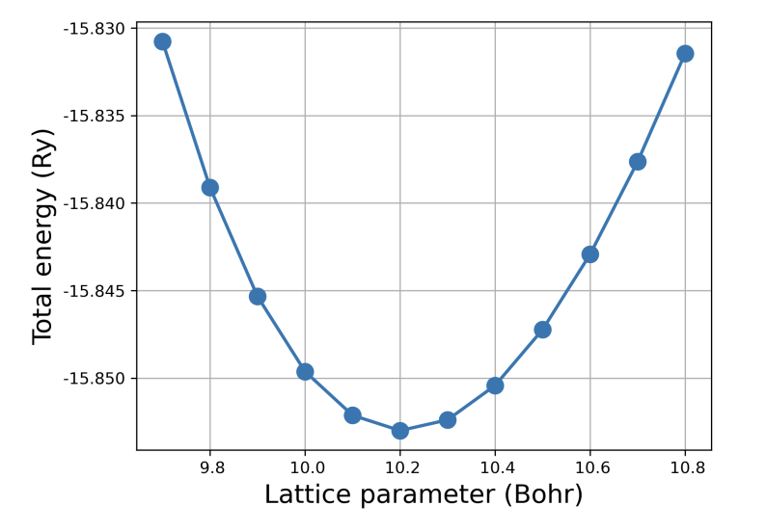
Lattice parameter determination
In silicon (Si), the equilibrium state is determined solely by the minimum-energy lattice parameter. Due to symmetry, there are no forces on the atoms.

Slide 25

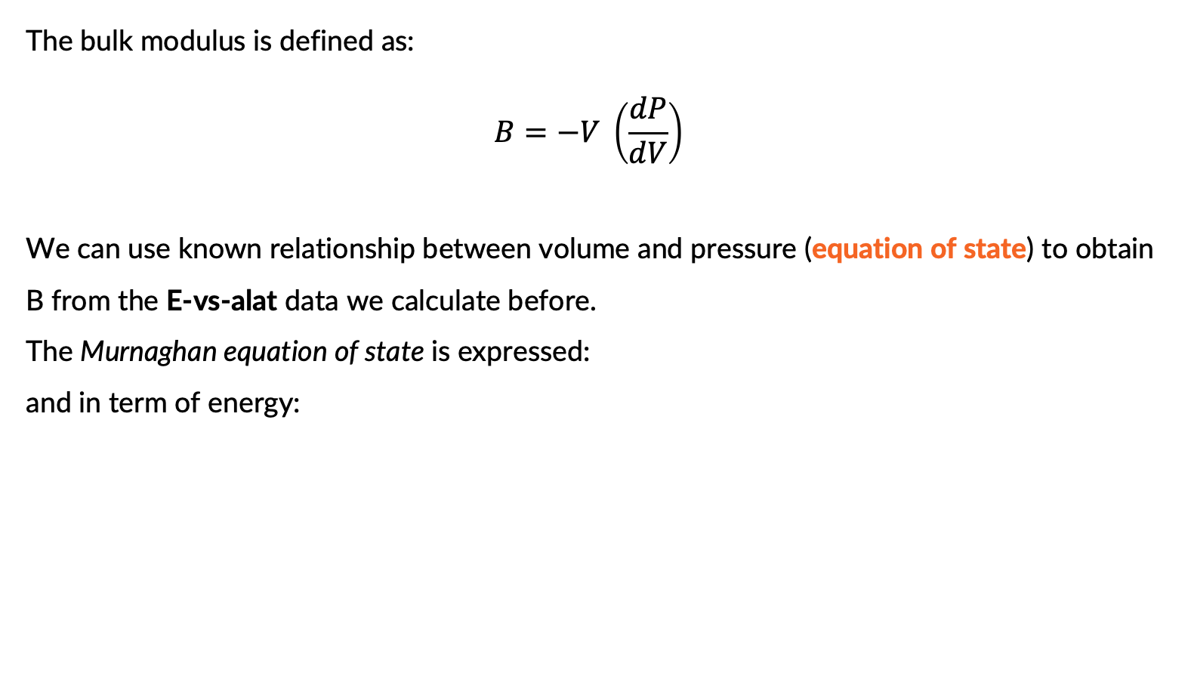

Extracting physical parameters: the Bulk modulus
The bulk modulus is defined as:
$$B=−V \left(\frac{dP}{dV}\right)$$
We can use known relationship between volume and pressure (equation of state) to obtain B from the E-vs-alat data we calculate before.
The Murnaghan equation of state is expressed:
and in term of energy:
$$P\left(V\right)=\frac{B_{0}}{B_{0}′}\left[{\left(\frac{V}{V_{0}}\right)}^{−B_{0}^{′}}−1\right]$$
$$E\left(V\right)=E_{0}+B_{0}V_{0}\left[\frac{1}{B_{0}^{′}({B^{′}}_{0}−1)}{\left(\frac{V}{V_{0}}\right)}^{1−B_{0}^{′}}+ \frac{1}{B_{0}^{′}}\frac{V}{V_{0}}− \frac{1}{B_{0}^{′}−1 }\right]$$

Slide 26
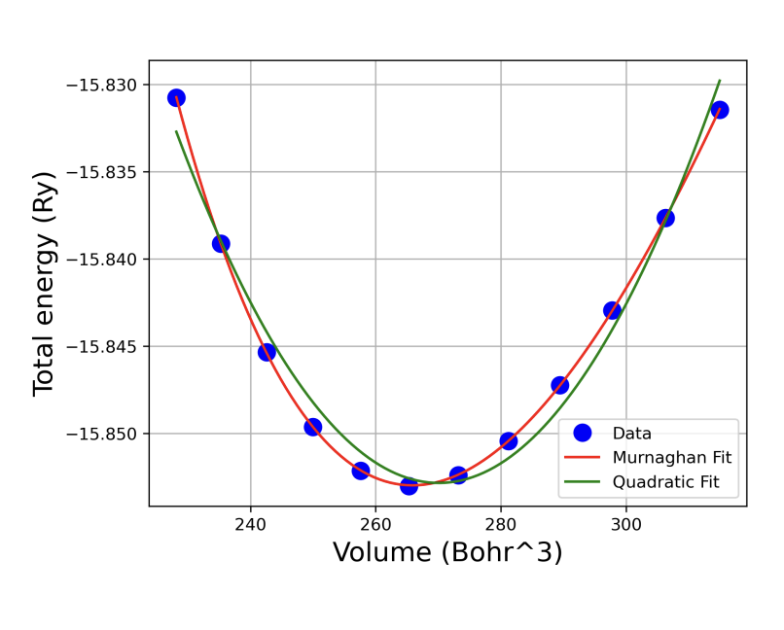
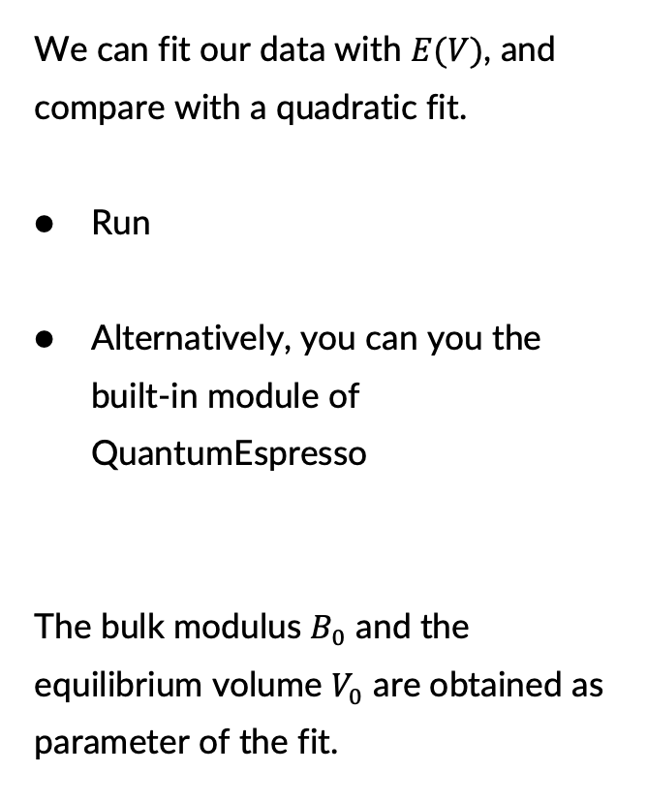
Extracting physical parameters: the Bulk modulus
We can fit our data with $E(V)$, and compare with a quadratic fit.
Run
Alternatively, you can you the built-in module of QuantumEspresso
The bulk modulus $B_{0}$ and the equilibrium volume $V_{0}$ are obtained as parameter of the fit.
python fit_volume.py
ev.x

Slide 27
Exercise 3 : Carbon chain
Introduction to low-dimensionality

Slide 28
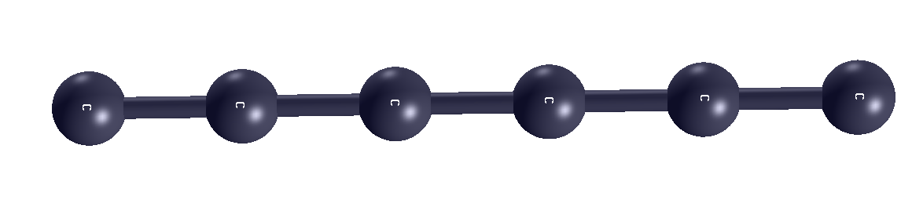
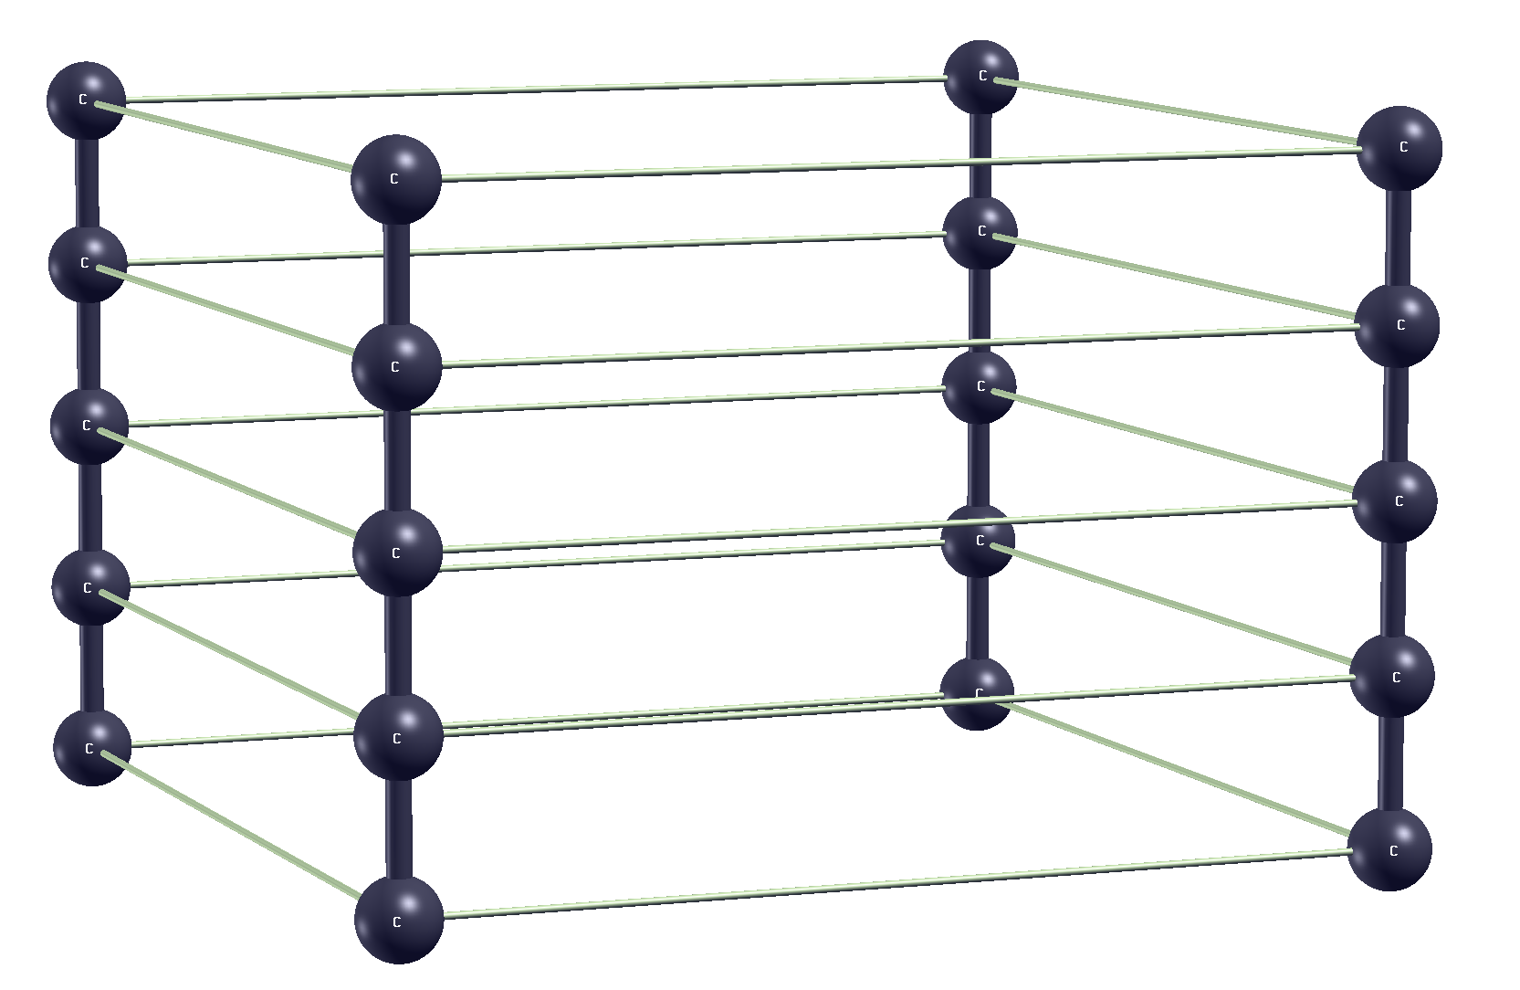
3. Carbyne, the carbyne chain
Carbyne is a chain composed of carbon
Periodic boundary conditions are applied in both directions. As seen in graphene, quantum espresso use periodic boundary condition.
z
y
x

Slide 29
3. Carbyne, the carbyne chain
&CONTROL calculation=‘?', prefix='carbyne', pseudo_dir=‘../../pseudo’, outdir='./tmp' tprnfor = .true. , tstress=.true. / &SYSTEM ibrav = 0, nat = ?, ntyp = ?, ecutwfc = 40, / &ELECTRONS / ATOMIC_SPECIES C C.pbe-n-kjpaw_psl.1.0.0.UPF ATOMIC_POSITIONS crystal C 0.00 0.00 0.00 K_POINTS automatic ? ? 30 0 0 0 CELL_PARAMETERS bohr 10 0.00000 0.0000 0.00000 10 0.0000 0.00000 0.00000 3.36
z
y
x

Slide 30
3. Carbyne, the carbyne chain
1. Visualize the structure using xcrysden.
2. Open the script scan_vacuum.sh and look at the input.
3. Fill the part left empty:
how many atom are in the unit cell, according to what you see with xcrysden?
How many atomic type?
What you expect to be a good value for the k-points along x and y direction?
&CONTROL calculation=‘?', prefix='carbyne', pseudo_dir=‘../../pseudo’, outdir='./tmp' tprnfor = .true. , tstress=.true. / &SYSTEM ibrav = 0, nat = ?, ntyp = ?, ecutwfc = 40, / &ELECTRONS / ATOMIC_SPECIES C C.pbe-n-kjpaw_psl.1.0.0.UPF ATOMIC_POSITIONS crystal C 0.00 0.00 0.00 K_POINTS automatic ? ? 30 0 0 0 CELL_PARAMETERS bohr 10 0.00000 0.0000 0.00000 10 0.0000 0.00000 0.00000 3.36

Slide 31
3. Vacuum space convergence
The space between each repetition of the chain need to be converged.
Converge the vacuum using the script scan_vacuum.sh , trying different values of the cell parameter along the vacuum direction
Store the result in a file, running gather_data.sh
(Note: some parts need to be filled! )
cell_parameter

Slide 32
3. Vacuum space convergence
Plot the result, with python plot_etot_vacuum.py or gnuplot plot.gp.
Open the script: plot_etot_diff_vacuum.py, try to understand it and fill the part left empty to plot the energy differences.
Try smaller values of cell parameter (e.g., 5 bohr) and plot the energy again. What do you see? Visualize the input file with xcrysden
What do you expect the total pressure would be when everything is well-converged?

Slide 33
Thank you!
Questions?

